Slide 1

VA.gov Impact Review: FSR
Debt Resolution Team
Linda Li , Debt Resolution Sr. Product Manager
July 23, 2021

Slide 2
Debt Resolution Team
Debt Resolution: FSR Impact Review, July 2021
Matt Self - Product Owner
Rebecca Walsh - Designer
Riley Orr - Designer
Craig Wheeler - FE Engineer
Justin Linn - FE Engineer
Kevin Mircovich - BE Engineer Linda Li - Senior Product Manager
Troy Riser - Content Writer
Jill Anderson - Main Stakeholder

Slide 3
Problem
Debt Resolution: FSR Impact Review, July 2021
The existing debt resolution process is complex, confusing and time consuming.
If a Veteran has debt with the VA that they cannot pay, they can ask for debt resolution which can be debt waver, compromise or a monthly offset/payment they can afford. The gatekeeper to start the debt resolution process is filling out and mailing or faxing in the FSR. The form is very confusing and while there is a how to guide for filling it out on va.gov/debtman, it is no less confusing. The process of printing, filling out and mailing/faxing in FSR form prevents Veterans from starting the process to resolving debts, which potentially leads to devastating benefits deductions and debt getting written off ruining credit. In addition to the FSR, the Veteran must write a letter explaining why they should be granted a waver, compromise or monthly payment plan which can be confusing and overwhelming, there are currently no guidelines or help as to what the letter must contain, or examples given.
Prior to this product, the Veterans had no way to send FSR form online.
This product is the first iteration of a technology based Debt resolution tool.

Slide 4
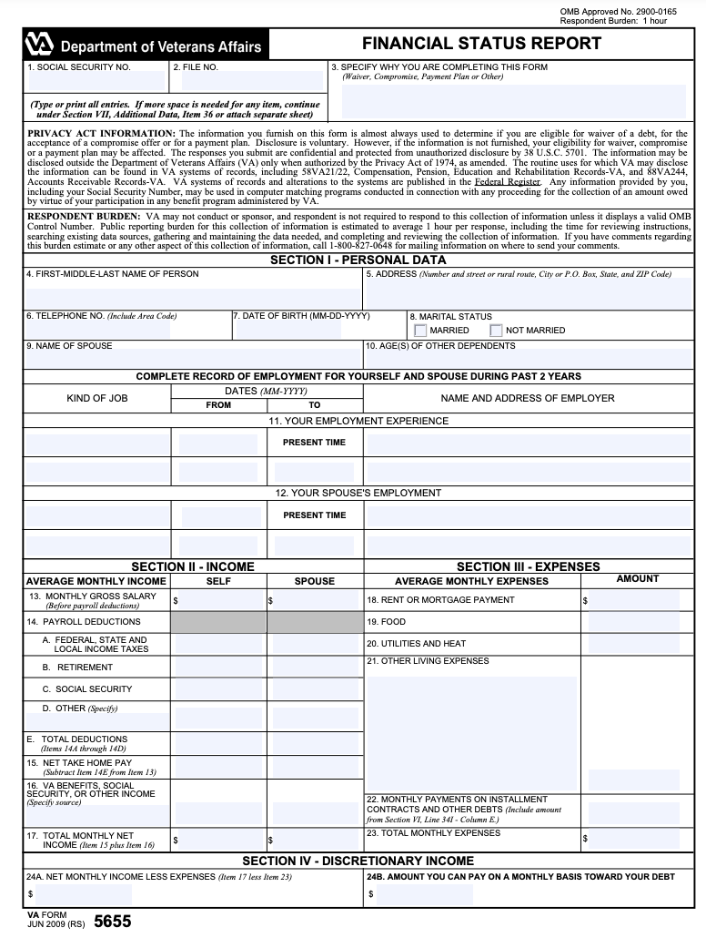
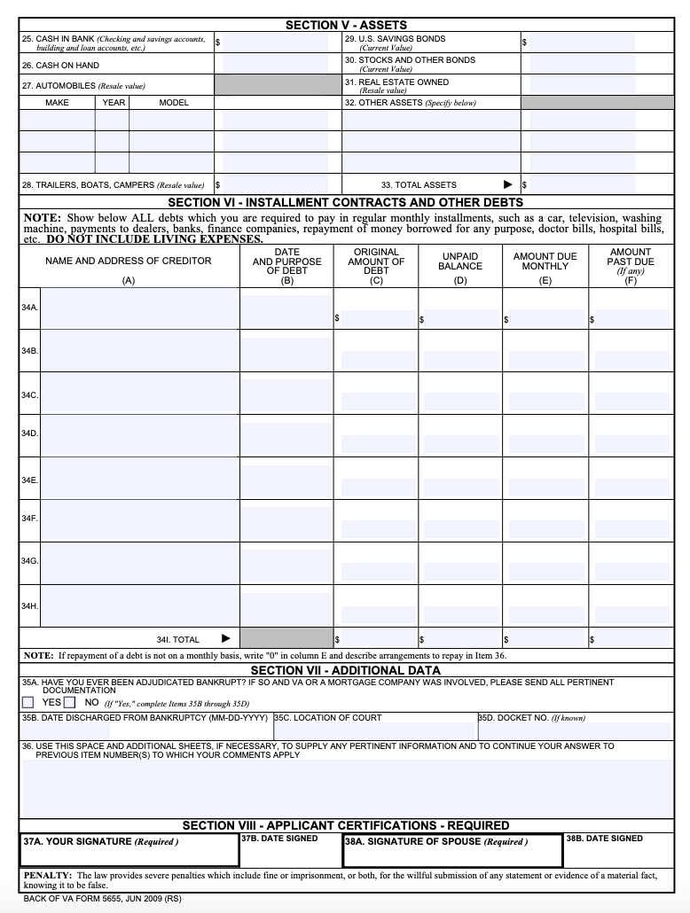
Current FSR form 5655

Slide 5
Solution, Hypotheses
Debt Resolution: FSR Impact Review, July 2021
Hypothesis: If we allow the veterans to electronically fill out and submit FSR form, their request will be received immediately and debt resolution process becomes much less complex, veterans will get their debt resolved within required timeframe less debt sent to treasury for collection.
Solution: A clearly structured FSR form for veterans to fill out and submit online also available to download if a veteran prefer to send by mail
How we did it: Deep, qualitative research with Veterans, SMEs, strong Stakeholder involvement.
Result: An effective product rolled out with minimal refinements.

Slide 6
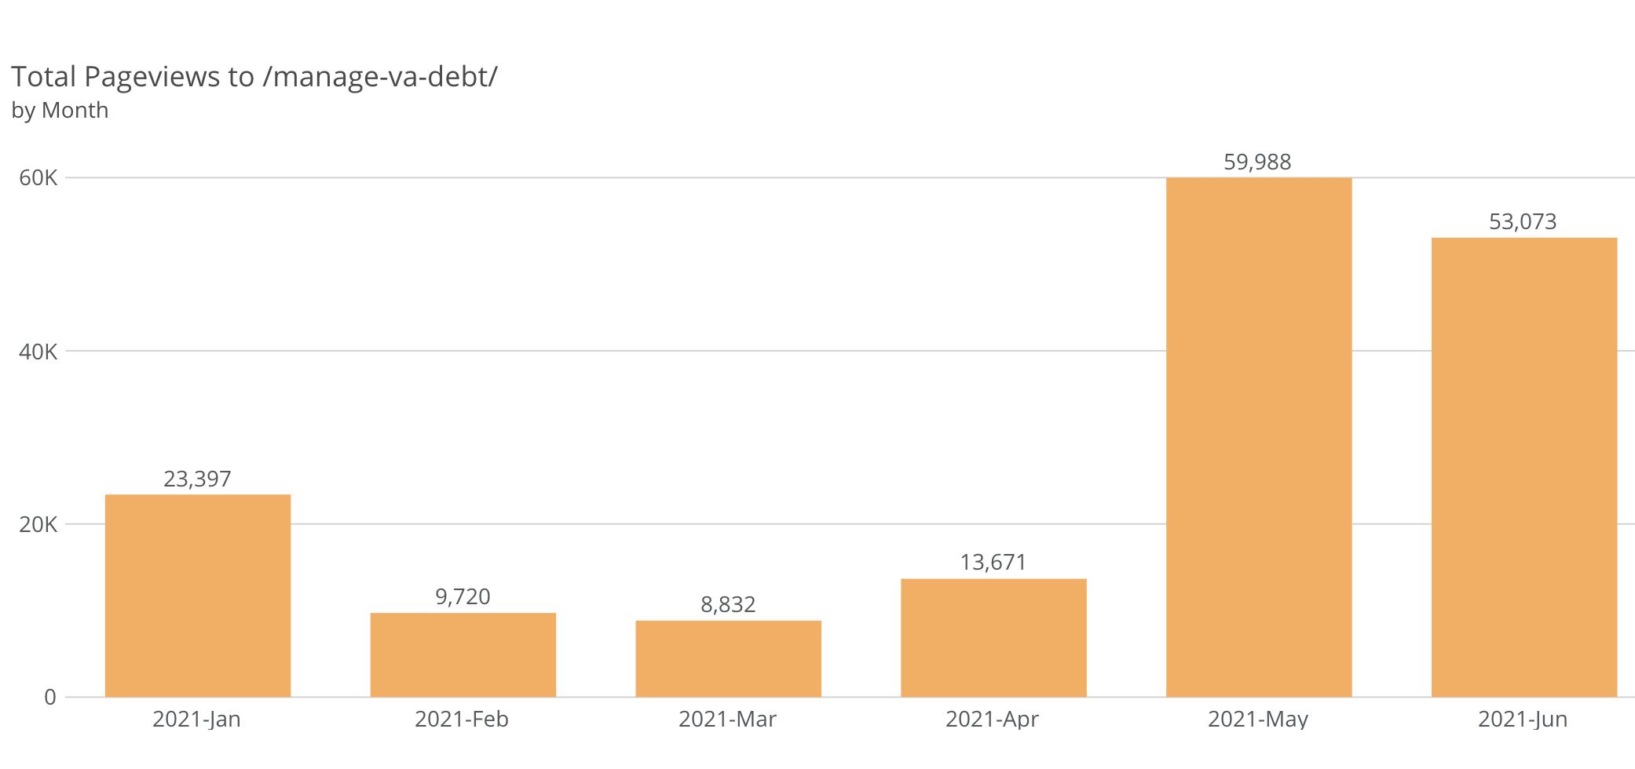

Slide 7
Results
Debt Resolution: FSR Impact Review, July 2021
Impact on Veterans, Business, and/or Technology
Quantitative
Qualitative

Slide 8
Open Discussion
Debt Resolution: FSR Impact Review, July 2021
Recommendations
(Seed this section with recommendations and plan to solicit additional recs/feedback during the discussion)
Notes

Slide 9
<Initiative> Impact Review, Month/Year
Executive Summary (to be completed after discussion)
Provide a summary of the following in prose or bullets:
Problem and why it was important to solve problem
Hypotheses
Quantitative Results
Recommendations

